Slide 1
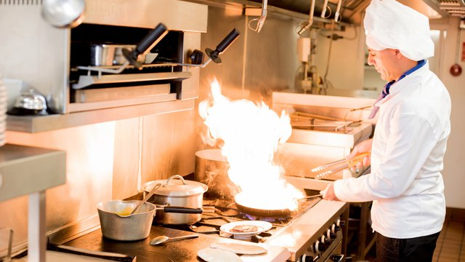
FOOD SAFETY IN RESTAURANT KITCHENs

Slide 2
INTRODUCTION
Team members:
Audience: Restaurants and commercial kitchens
FOOD SAFETY IN RESTAURANT KITCHENS

Slide 3
Problem
Customers dying from foodborne illnesses
Customers hospitalized due to food poisoning
Cross contamination in restaurants and commercial kitchens.

Slide 4
Problem Statement
The Central for Disease Control says that nearly 1 person out of 6 die out of insufficient food safety.
About 128,000 are hospitalized as a result and 3,000 die each year.

Slide 5
Purpose
This study intends to provide tips that restaurant kitchens can apply to help minimize and possibly put an end to people dying due meager food safety.

Slide 6
Scope
Some of the issues to be discussed in this presentation are the factors that lead to foodborne diseases and what can be done about it to enhance zero foodborne illnesses. Some of the factors to be considered include; hand washing, proper washing of food, the use of gloves, keeping sick workers away from food preparation, food storage and safe food temperatures.

Slide 7
Results

Slide 8
Benefits of food safety
Reduction in cross contamination cases
Minimization of foodborne illnesses
Minimization deaths due to meager food safety
Reduction in fodborne illnesses hospitalization cases
Minimization of health risk to kitchen staff and customers in general.

Slide 9

FOOD SAFETY IN RESTAURANT KITCHEN
Promoting hand wash is imperative for restaurant kitchens.
This would be promoted by establishing a hand washing station for employees.
This would minimize cross-contamination by having employees washing hands before touching any food.
Even the smallest bacteria can make one sick if its on a piece of food. Hand washing is key.

Slide 10

FOOD SAFETY IN RESTAURANT KITCHEN
Sick workers should not be allowed to make food.
When workers at a restaurant are suffering from suffering or diarrhea, they should be kept away from food.
If they happen to prepare food, they are putting customers’ health at risk.
This should be common sense for restaurant owners, they do not need safety tips to know that.

Slide 11
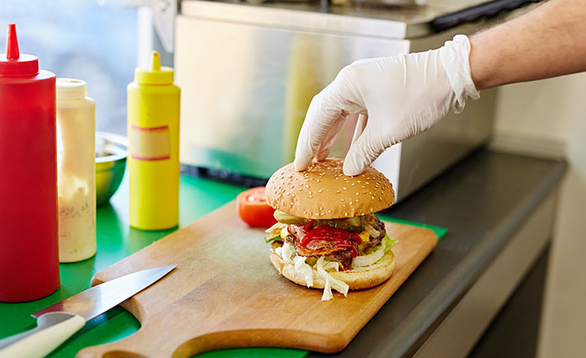
FOOD SAFETY IN RESTAURANT KITCHEN
Use of gloves should be embraced.
Workers in restaurant kitchens should be wearing gloves when preparing food.
However, they cannot use the same gloves for different ingredients. They have to change when moving from one ingredient to another.
In the event they don’t change the gloves, they can spread contaminants to customers food which may result to food poisoning

Slide 12
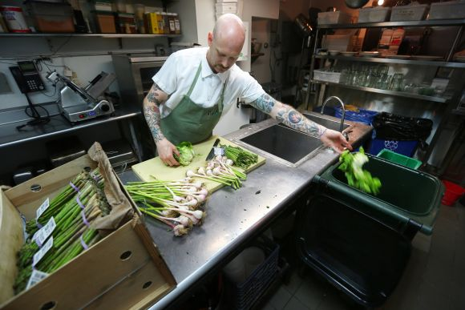
FOOD SAFETY IN RESTAURANT KITCHEN
Food should be washed properly.
Foods such as fruits and vegetables should be washed properly.
Even if the vegetables will be peeled or skinned, they require thorough washing or the workers risk spreading contamination to customers.

Slide 13
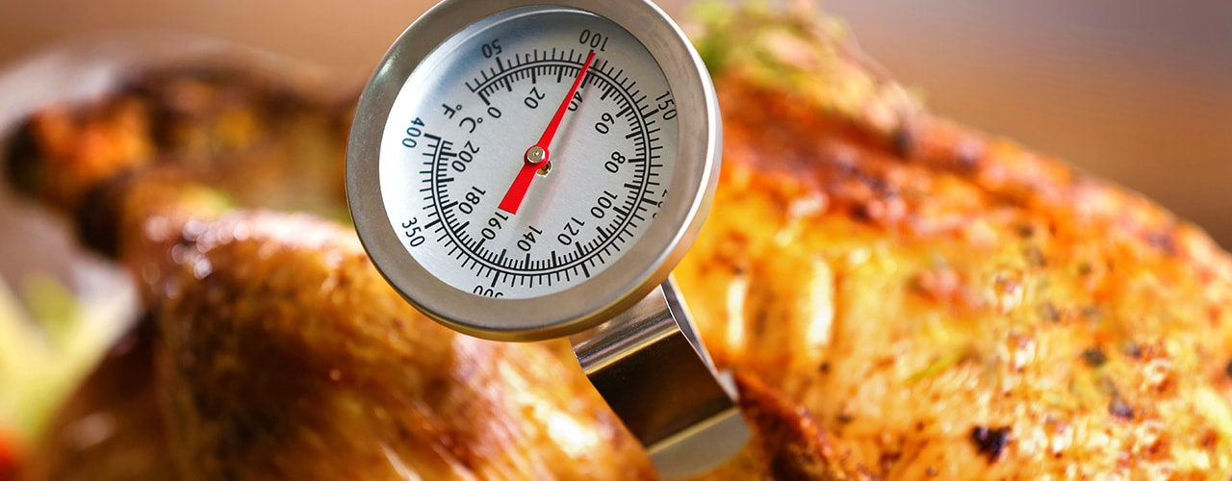
FOOD SAFETY IN RESTAURANT KITCHEN
Food should be cooked to the right temperature.
It is an imperative tip to know safe food temperature zones.
For instance beef should be at 155 degrees for 15 seconds.
This is to prevent E-coli found in food ground which accounts for many cases of food illnesses.

Slide 14
Conclusion
Food safety should be a priority in every restaurant and even homes too. Meager food safety can cause adverse impact to customers and people in general. For this reason, good business planning is tied to a solid food safety procedure. A culture of food safety in any restaurant’s kitchen is key to serving the best food possible. The take home message for restaurants is that; start with food safety and you will end up with satisfied customers.

Slide 15
Recommendations
Observing food safety in the restaurant and commercial kitchens can reduce cases of Foodborne illnesses.
Food safety should come first in restaurants to enhance smooth business running and health of both the staff and customers.

Slide 16
Reference
Park, S. H., Kwak, T. K., & Chang, H. J. (2010). Evaluation of the food safety training for food handlers in restaurant operations. Nutrition research and practice, 4(1), 58-68.
Brown, L. G., Le, B., Wong, M. R., Reimann, D., Nicholas, D., Faw, B., ... & Selman, C. A. (2014). Restaurant manager and worker food safety certification and knowledge. Foodborne pathogens and disease, 11(11), 835-843.

